Slide 1



PO_CLOSURE_ACTIVITY
View in Power BI
Last data refresh:
7/6/2022 5:23:21 AM UTC
Downloaded at:
7/26/2022 10:51:33 AM UTC

Slide 2
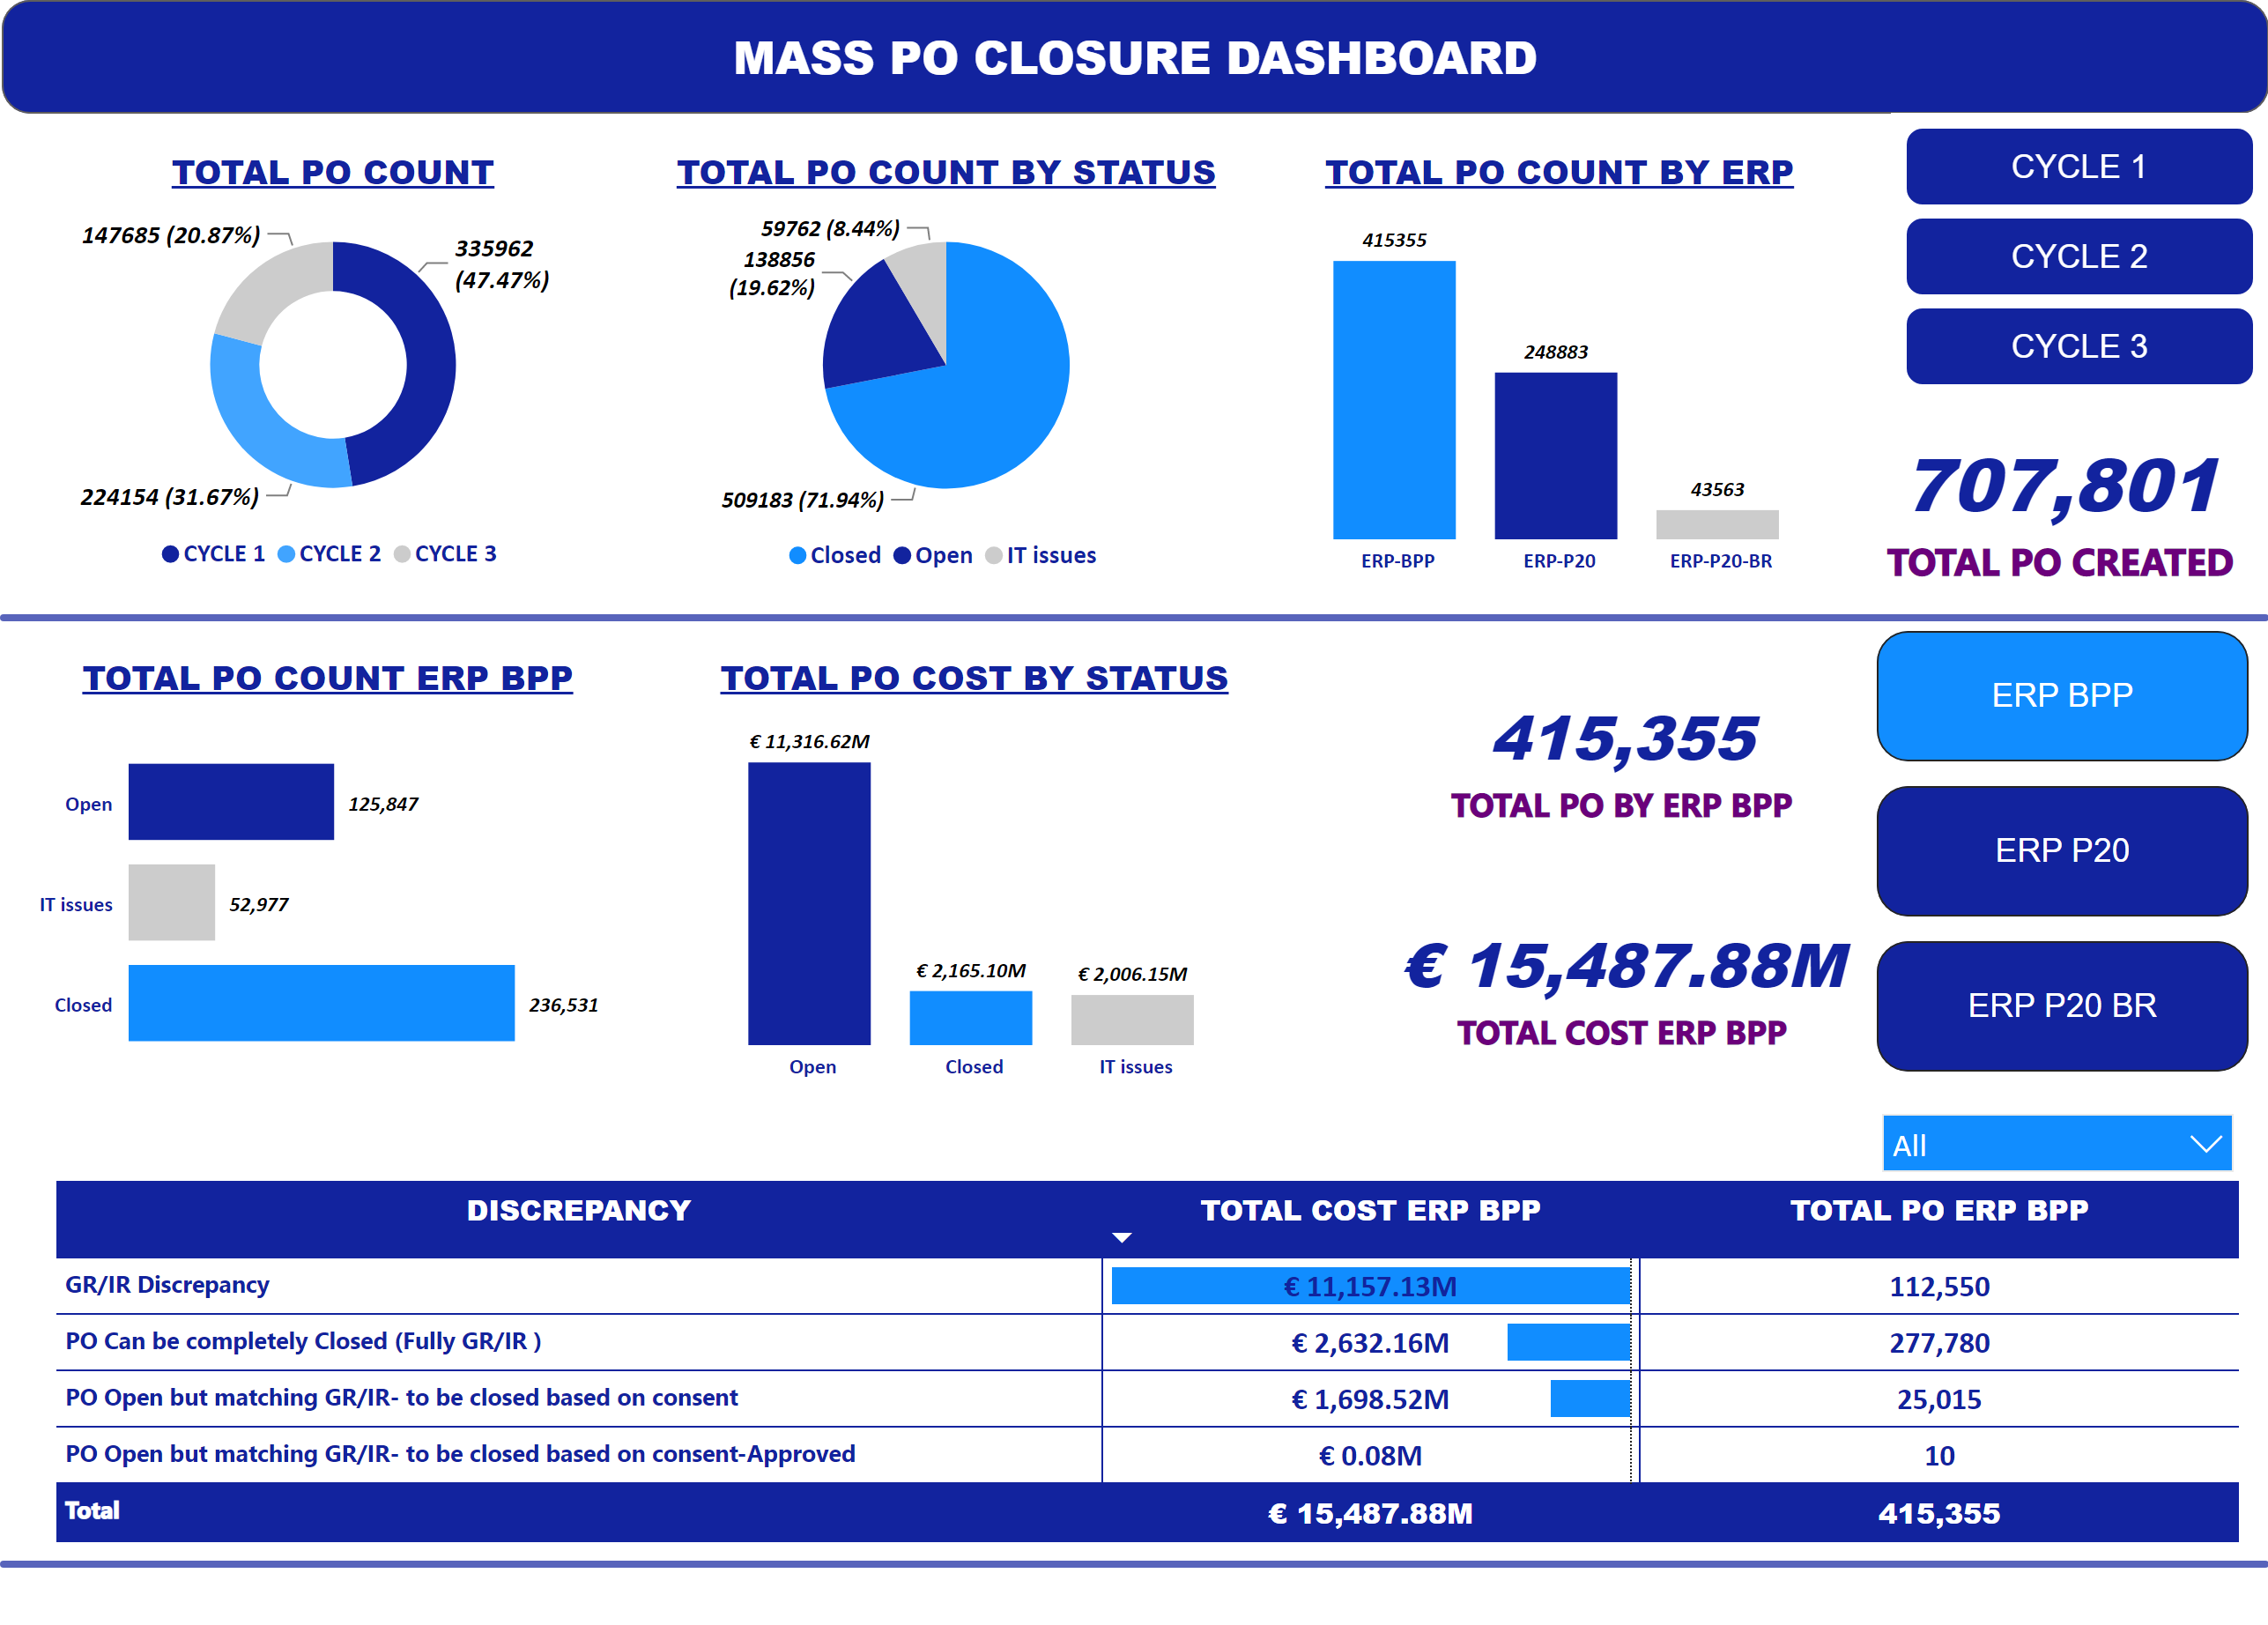
OVERVIEW
Notes:
shape
No alt text provided
ChicletSlicer1448559807354
No alt text provided
shape
No alt text provided
Bookmark_Pane
No alt text provided
card
No alt text provided
card
No alt text provided
pivotTable
No alt text provided
slicer
No alt text provided
clusteredColumnChart
No alt text provided
barChart
No alt text provided
card
No alt text provided
card
No alt text provided
clusteredColumnChart
No alt text provided
barChart
No alt text provided
pivotTable
No alt text provided
slicer
No alt text provided
card
No alt text provided
card
No alt text provided
pivotTable
No alt text provided
slicer
No alt text provided
TOTAL PO COST BY STATUS
No alt text provided
TOTAL PO COUNT ERP BPP
No alt text provided
actionButton
No alt text provided
TOTAL PO COUNT
No alt text provided
TOTAL PO COUNT BY STATUS
No alt text provided
card
No alt text provided
TOTAL PO COUNT BY ERP
No alt text provided

